Slide 1

Data Breach Analysis - HAP 745
File created on: 5/17/2022 12:13:54 AM
This Photo by Unknown Author is licensed under CC BY-NC

Slide 2
This project looks at data from the Department of Health and Human Services’ Office and Office for Civil Rights (OCR).
It includes analyses of cases of different types of breaches, the specific location of the breach, the State in the country, and the covered entities that the violation has impacted.
This analysis is been interpreted with the data visualization tool, Tableau.
Background

Slide 3
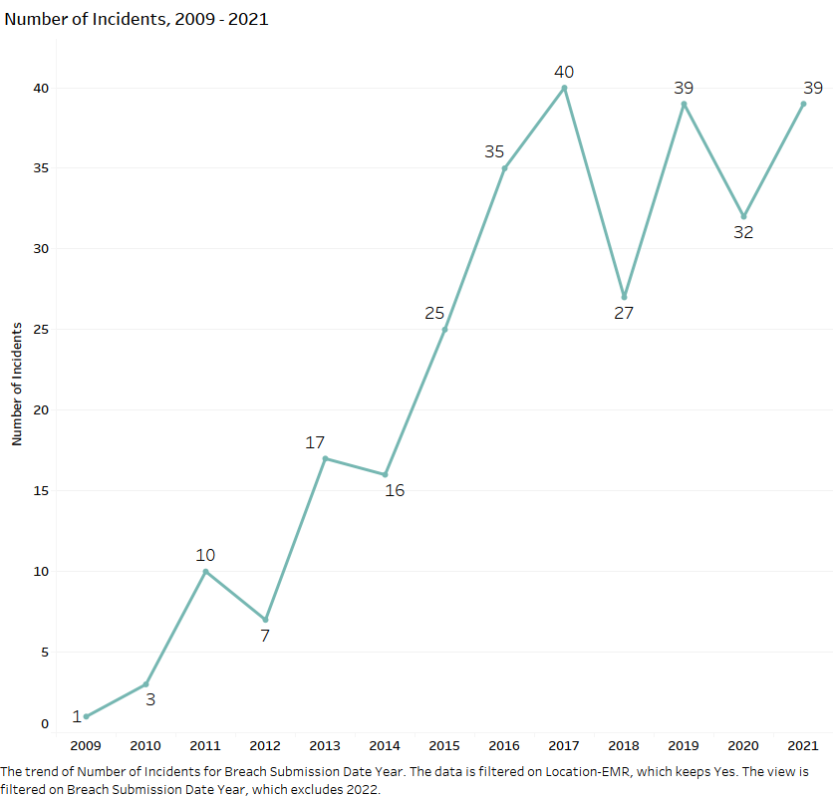
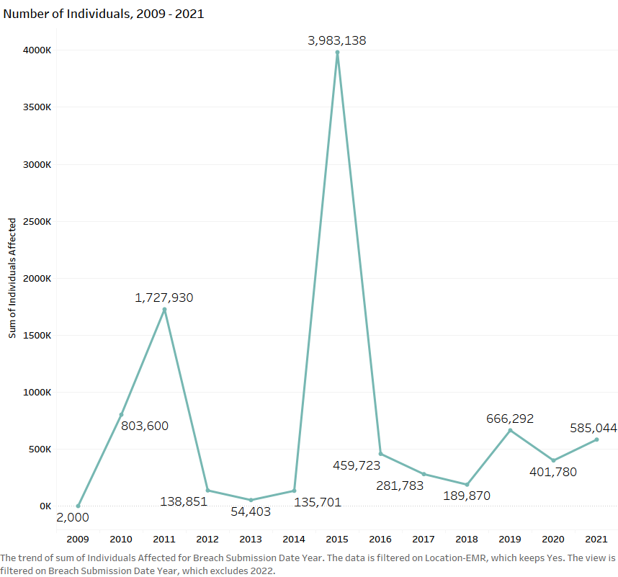
Graph showing number of Incidents and number of Individuals affected by Breach
Location – EMR
This excludes 2022

Slide 4
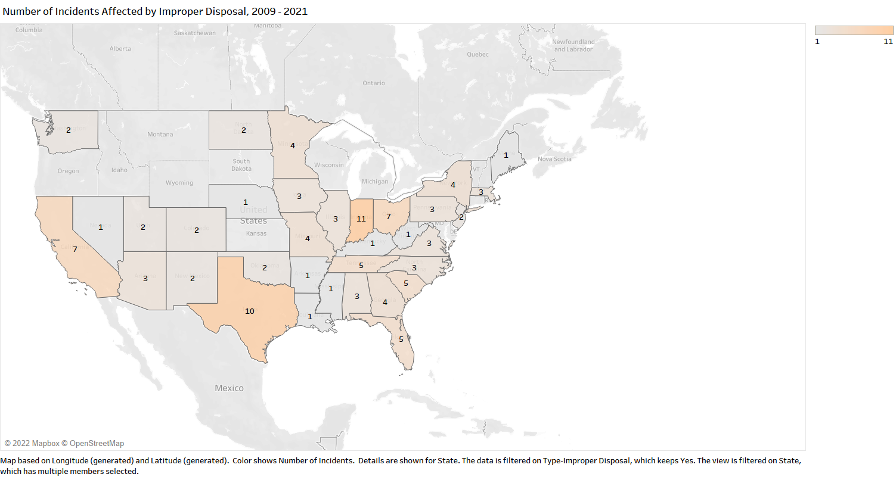
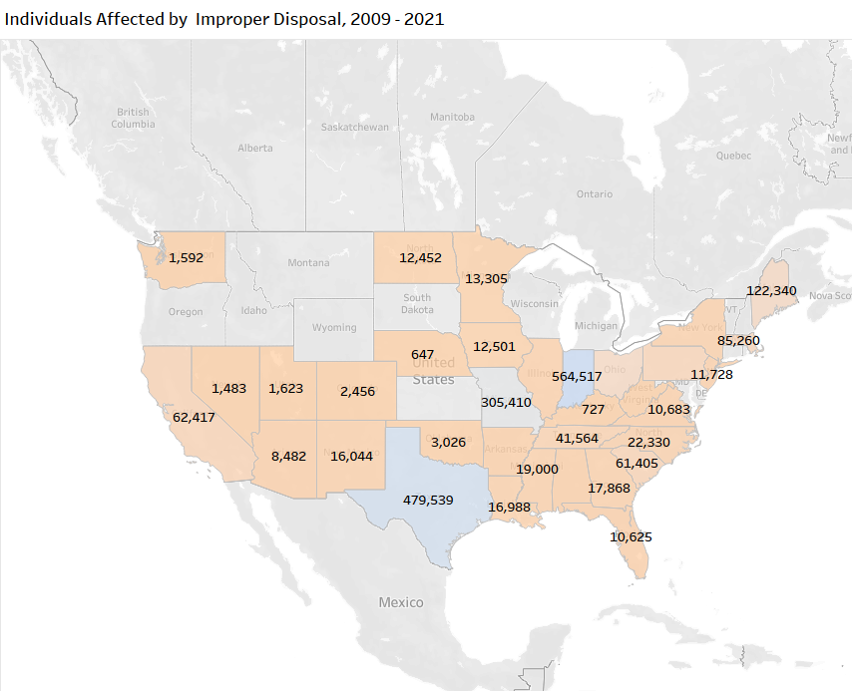
This map shows number of incidents and individuals affected by Improper disposal. Indiana state has the highest number of Incidents, and same applies to the number of Individuals affected.

Slide 5
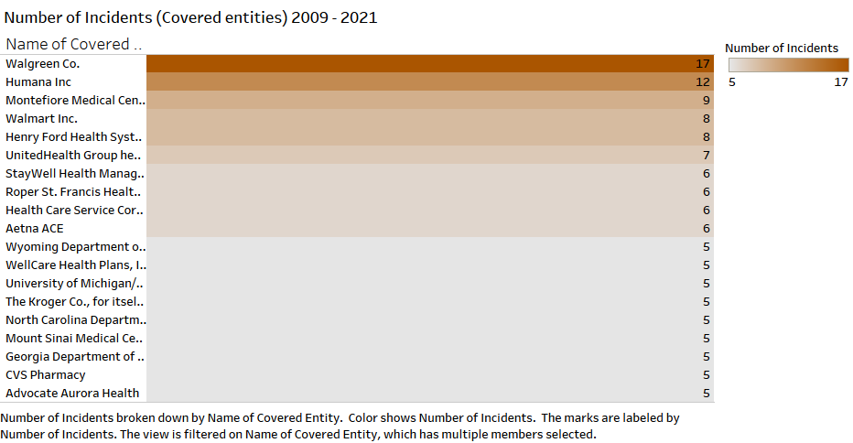
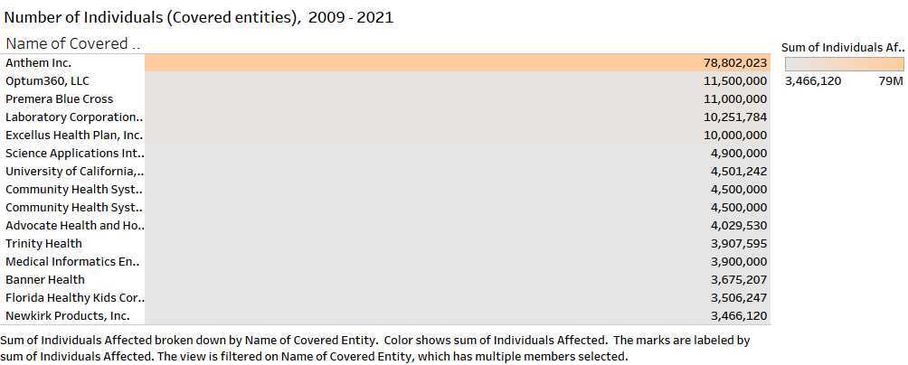
It is seen on this chart that Walgreens has about 17 data breach incidents. The chart has a condition to reveal covered entities with five or more breach incidents. Aetna ACE experienced a total of 6
An example of an OCP/HIPPA sanction from the article is that of Aetna, where they were sanctioned with 1M dollars due to multiple breaches within a year. Three, to be exact.

Slide 6
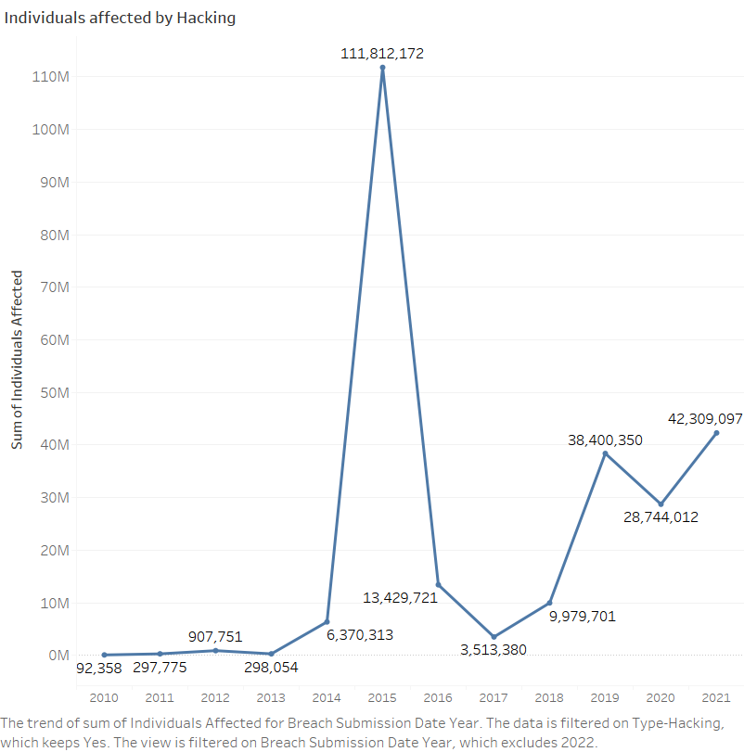
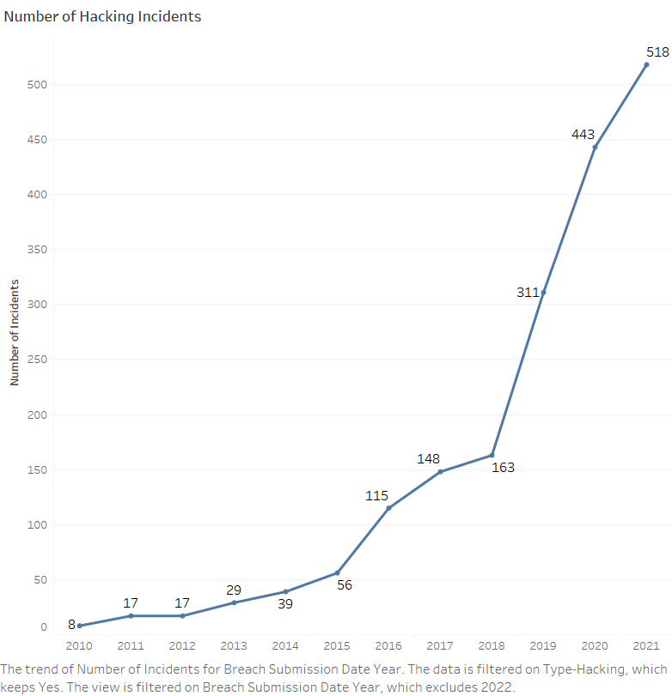
This line graph shows the number of incidents and Individuals affected by the hacking. It also highlights that sometimes, the incidents may be low, but the number of individuals may be very high. For example, in 2015, we can see a record 56 incidents. However, the number of individuals affected was over 100M

Slide 7
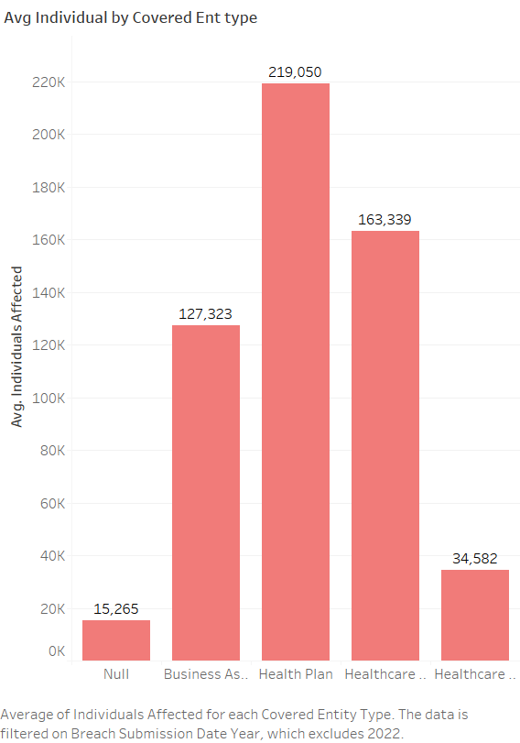
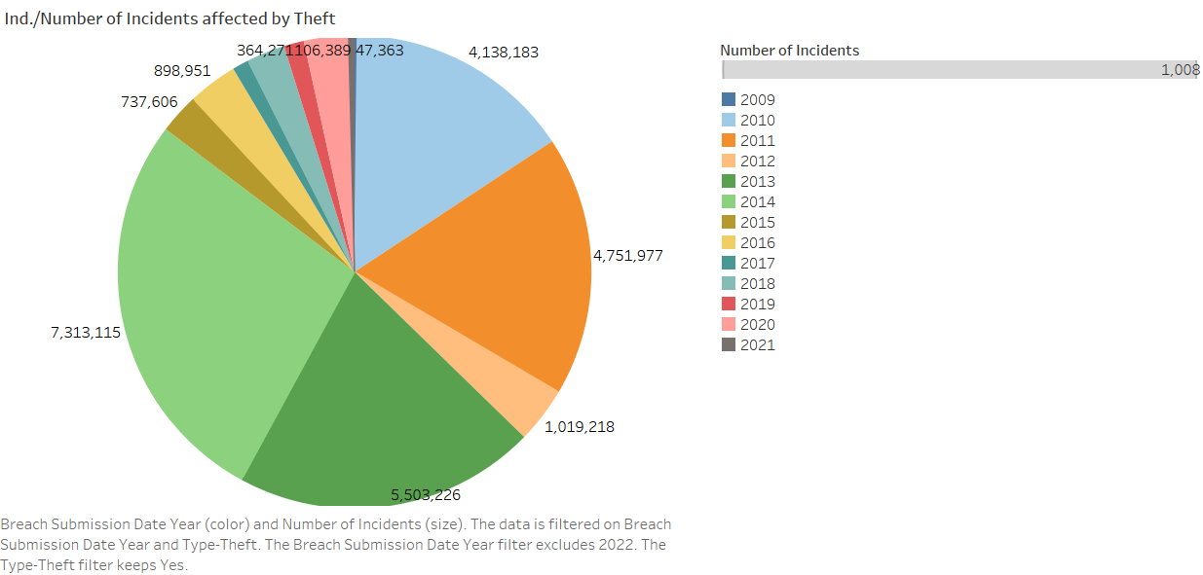
The bar chart shows the average number of individuals based covered entity type. Health plan having the highest number of Individuals affected
This pie chart shows number of Incidents/individuals affected by theft. It indicates the year as well.

Slide 8
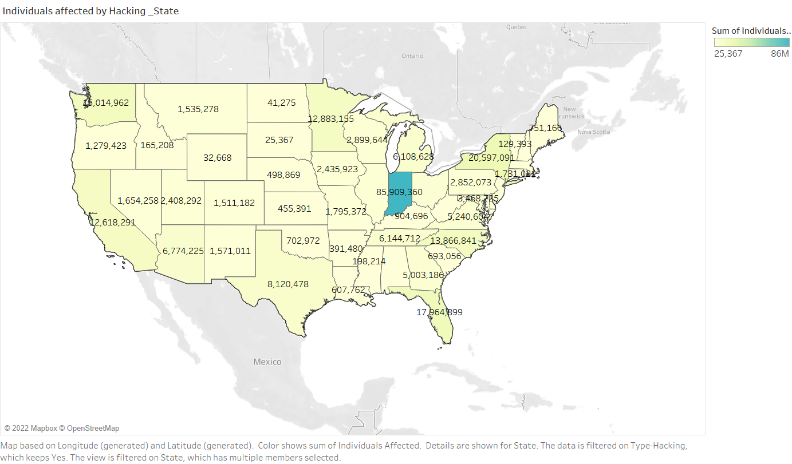
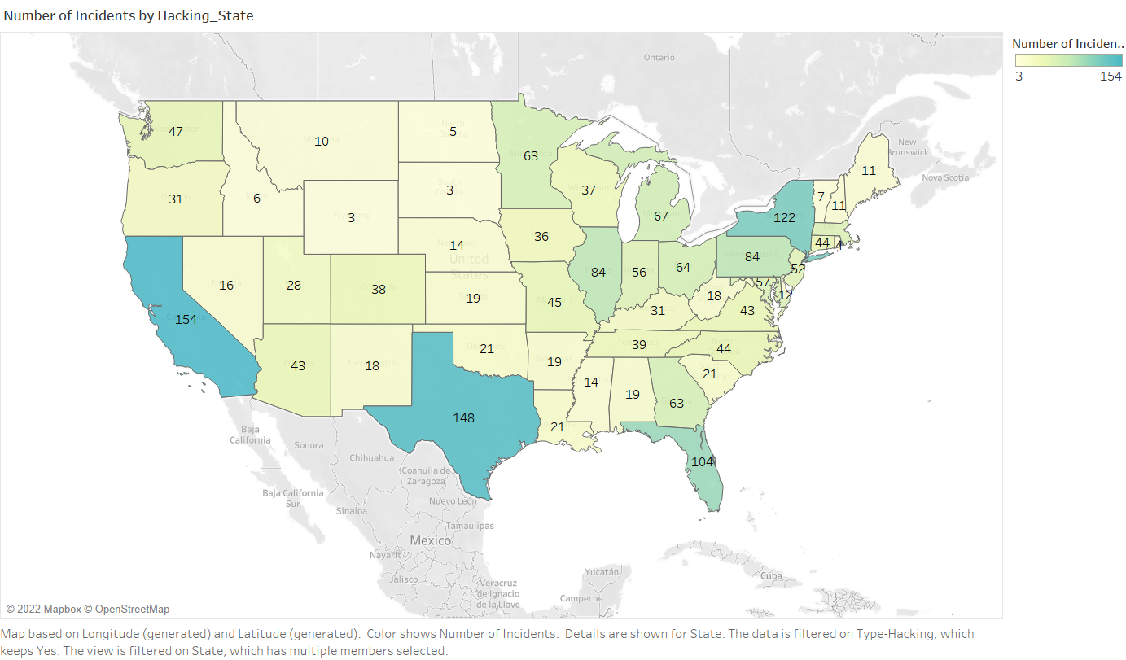
This map shows Texas and California having high incidents. However, Indiana has the highest number of Individuals affected by the Hacking. I believe this shows how sophisticated and well-targeted these hackers can be.

Slide 9
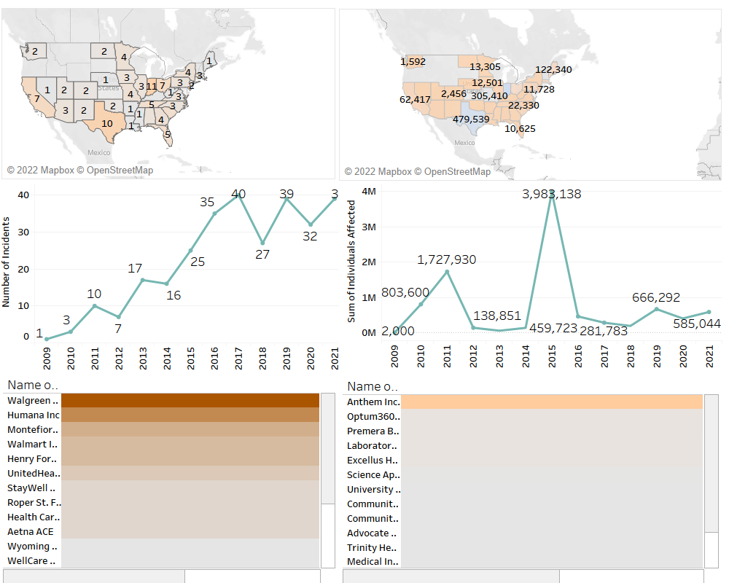
Dashboard showing a compressed Summary of charts

Slide 10
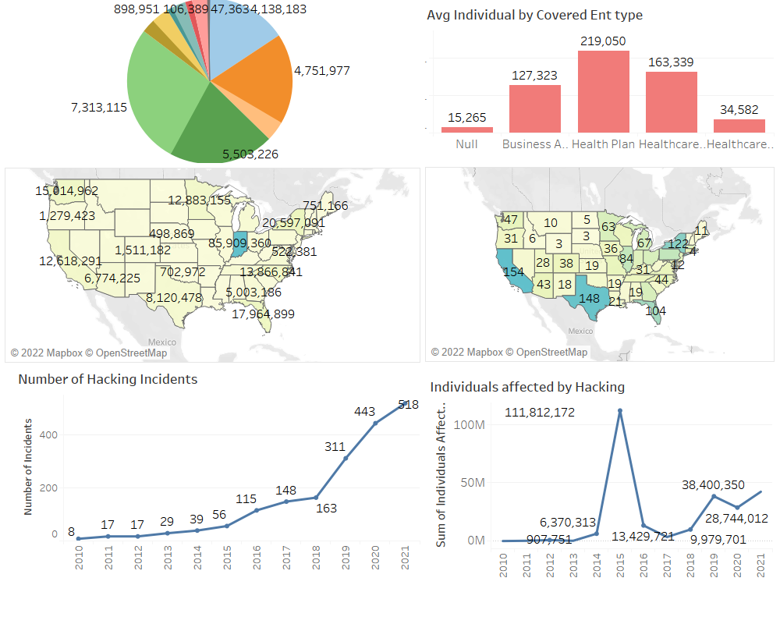
Dashboard Cont’d

Slide 11
Conclusion
We must monitor and track these events. It is no news the cost of these breach Incidents. For this reason, the Office of Civil Rights, OCR is beginning to take an active stance in auditing and educating covered entities and business entities on the importance of implementing the proper controls, specifically when it comes to monitoring to prevent breaches.

Slide 12
References
https://www.hipaajournal.com/what-information-is-protected-under-hipaa-law/
https://www.threatstack.com/blog/the-importance-of-security-monitoring-to-achieving-compliance-in-the-cloud#:~:text=Without%20this%20information%2C%20companies%20can,major%20financial%20and%20reputation%20consequences.

